Slide 1
Phase 01 Air quality analysis
Sooyeon Choi

Slide 2
Introduction
The United States Environmental Protection Agency (EPA) provides access to air quality data (primarily from Air quality system (AQS) database) collected at outdoor monitors across the United Sates, Puerto Rico, and the U.S Virgin Islands.
Project Goal: Categorize into various clusters to see how the pollution is distributed geographically.
(Ozone, Sulfur Dioxide, Carbon Monoxide, Nitrogen Dioxide)
Clustering will help me find how the different states/regions differ in air pollution with different types of gas. With this information, I plan to find suggestions on how to reduce air pollution.

Slide 3
Overview of similar approaches
European ozone measurements examined through a cluster analysis (CA) of 4 years of 3-hourly ozone data from 1492 European surface monitoring stations in the Airbase database
Propose the use of air quality index and the development of advanced data processing, analysis, and visualization techniques based on the AI-based k-clustering method, based in China.
Novel hybrid learning method, carried out to forecast urban air quality index (AQI). Wavelet packet decomposition (WPD) was firstly performed to decompose the original AQI data into lower-frequency subseries. (China)
Cluster analysis of European surface ozone observations for evaluation of MACC reanalysis data
Authors: Olga Lyapina, Martin G. Schultz, and Andreas Hens
2. K-Clustering Methods for Investigating Social-Environmental and Natural-Environmental Features Based on Air Quality Index
Authors: Victor Chang; Pin Ni; Yuming L
3. A clustering-based ensemble approach with improved pigeon-inspired optimization and extreme learning machine for air quality prediction
Author: Feng Jiang a,, Jiaqi He a, Tianhai Tian b

Slide 4
Dataset & eda
The Data set is retrieved from United States Environmental Protection Agency (EPA).
There are 4 datasets that will be used. Each contains same categories except the criteria gases:
Daily Summary dataset for Ozone (44201) 2020 contains 391,923 Rows, 24 Columns, and is 3,127 KB. It contains numerical and categorical data.
Daily Summary dataset for Sulfur dioxide (SO2 (42401)) 2020 contains 324,817 Rows, 24 Columns, and is 4,357 KB. It contains numerical and categorical data.
Daily Summary dataset for Carbon Monoxide (CO (42101)) 2020 contains 178,789 Rows, 24 Columns, and is 1,784 KB. It contains numerical and categorical data.
Daily Summary dataset for Nitrogen dioxide (NO2 (42602)) 2020 contains 157,726 Rows, 24 Columns, and is 2,159 KB. It contains numerical and categorical data.

Slide 5
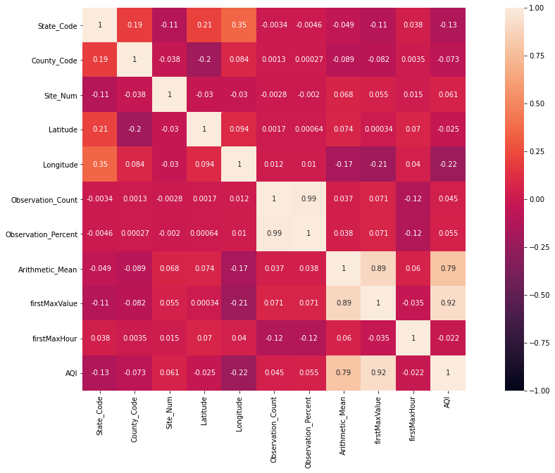

Slide 6
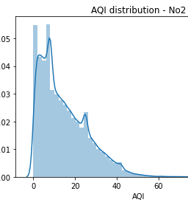
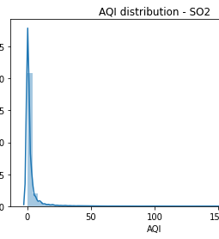
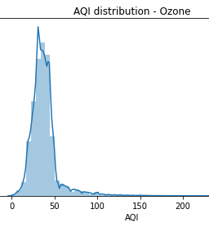
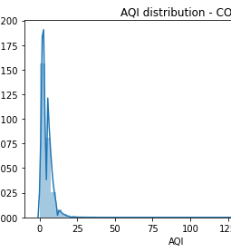
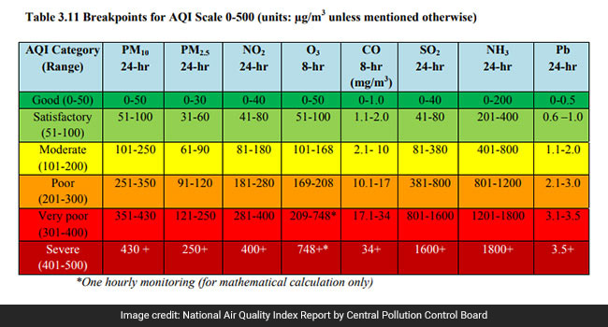
EDA (AQI)
**Unit of measure**
Ozone, carbon monoxide: Parts per million
Nitrogen dioxide (NO2), Sulfur dioxide :Parts per billion

Slide 7
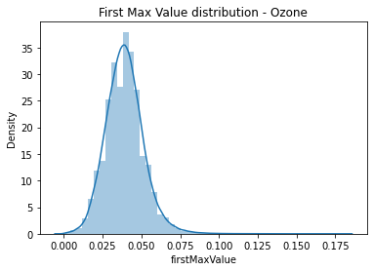
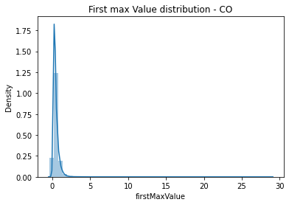
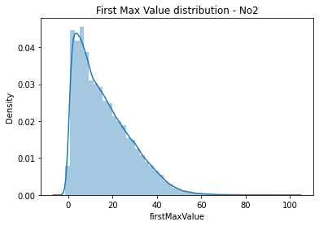
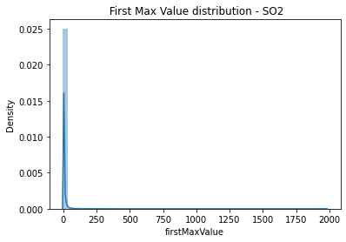
First max value

Slide 8
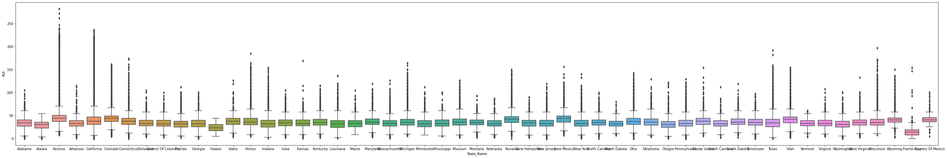
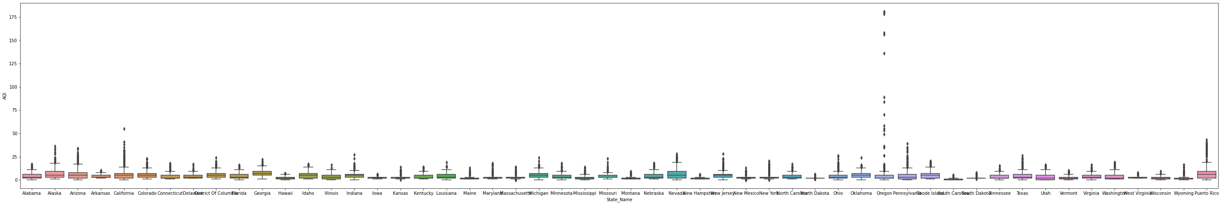
Ozone
Arizona has high AQI with highest and the most outliers. This shows that the AQI in the state seems to be very inconsistent.
On the other hand, Alaska and Hawaii has a low AQI with no outlier. The AQI for ozone seems to be consistent.
Carbon Monoxide
Oregon is the only state that has very high AQI with the outliers.

Slide 9
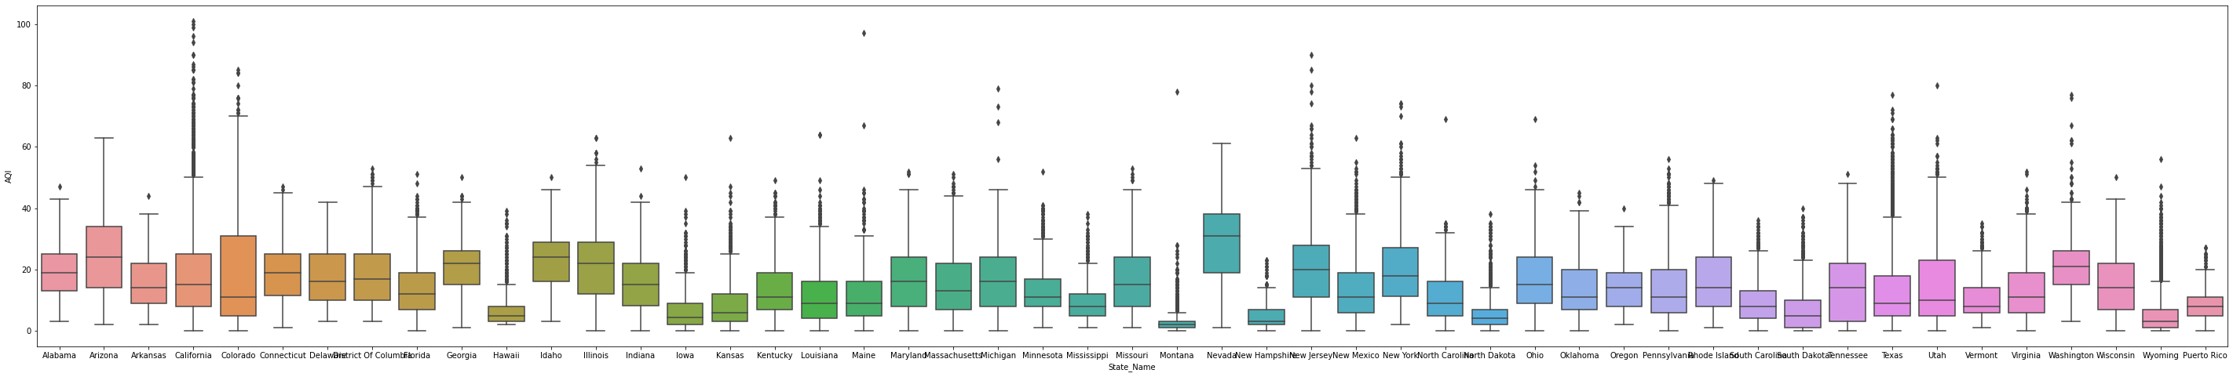
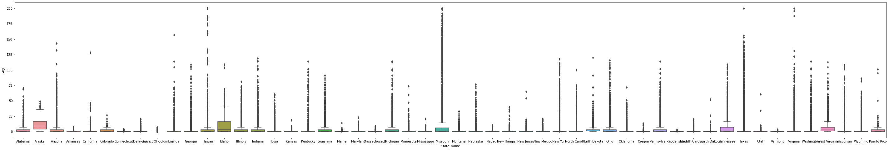
Nitrogen Dioxide
Nevada has a high AQI with no outliers. Very consistent.
Sulfur Dioxide
Overall, most of the states have many outliers which suggests that sulfur dioxide AQI is inconsistent.
Alaska has highest AQI with some low outliers.
Hawaii, Texas, and Virginia has low AQI but very high outlier.

Slide 10
Next steps
Plotly express for geographical visualization
Clustering analysis / Evaluation
Finding Solutions with findings

